Slide 1

Health services
Preventive Services Offered Under the Affordable Act

Slide 2
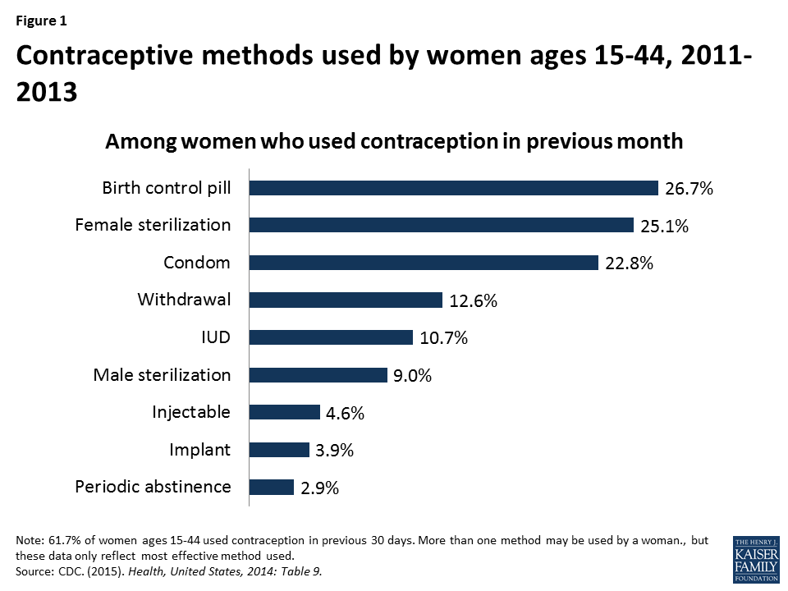
HEALTH SERVICES
Diet Counselling for Adults
Contraception for Women
Drug use Assessments for Adolescent Children

Slide 3



HEALTH services
Diet counselling for adults
Diet counselling for adults is an interesting service to me as it helps a great deal in guiding the aged population on which kinds of foods to consume for a better health.
Diet counselling for adults is only given freely to a few adults.
To increase the number of adults reached by diet counselling, the service should be community based where the service providers will go from one home to the other.
Diet Counselling for Adults: The adults are taken through nutritional education, and counselling in order to meet the normal and therapeutic needs.

Slide 4
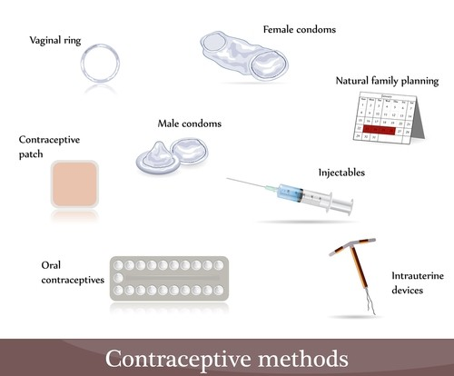

Health services
Contraception for women
The second service, contraception for women, is of interest to me since it helps women to choose the right method for birth control.
An obvious fact about contraception for women is that some religions like Christianity have not embraced them fully
Contraception services should be intensified among Christian women to help them accept and use the right birth controls.
Contraception for Women: The service avails counselling, contraceptive education, preconception health services, breast screening and cervical cancer, and HIV test and counselling.

Slide 5
HEALTH SERVICES drug use assessment for adolescent children
The third service, drug use assessments for adolescent children, is of great interest to me since it helps children to avoid engaging in drug and substance abuse that could otherwise hamper their body and mental health.
Drug assessment services for children has not been taken seriously especially by the adolescents.
Drug use Assessment for Adolescent Children: The health providers utilizes the Adolescent Community Reinforcement Approach (A-CRA) where they help the NY teens to build social, educational and familial connections which reinforce positive motivation and helps improve drug refusal skills.

Slide 6
HEALTH SERVICES references
http://www.americashealthrankings.org/
http://www.countyhealthrankings.org/
https://www.google.com/search?q=images+of+HEALTH+SERVICES&client=firefox-b-ab&tbm=isch&source=iu&ictx=1&fir=427EVCJGJrIizM%253A%252C92KzOkaqlkOVsM%252C_&usg=AI4_-kSDmmeqWeUhBSt2vfoEMDvyJb6NTw&sa=X&ved=2ahUKEwjSrdzYu7LeAhVCExoKHaoGA5oQ9QEwB3oECAYQEg#imgrc=427EVCJGJrIizM:

